Slide 1
Phishing Awareness Training
Understanding the Different Types of Phishing Attacks and Their Prevention

Slide 2
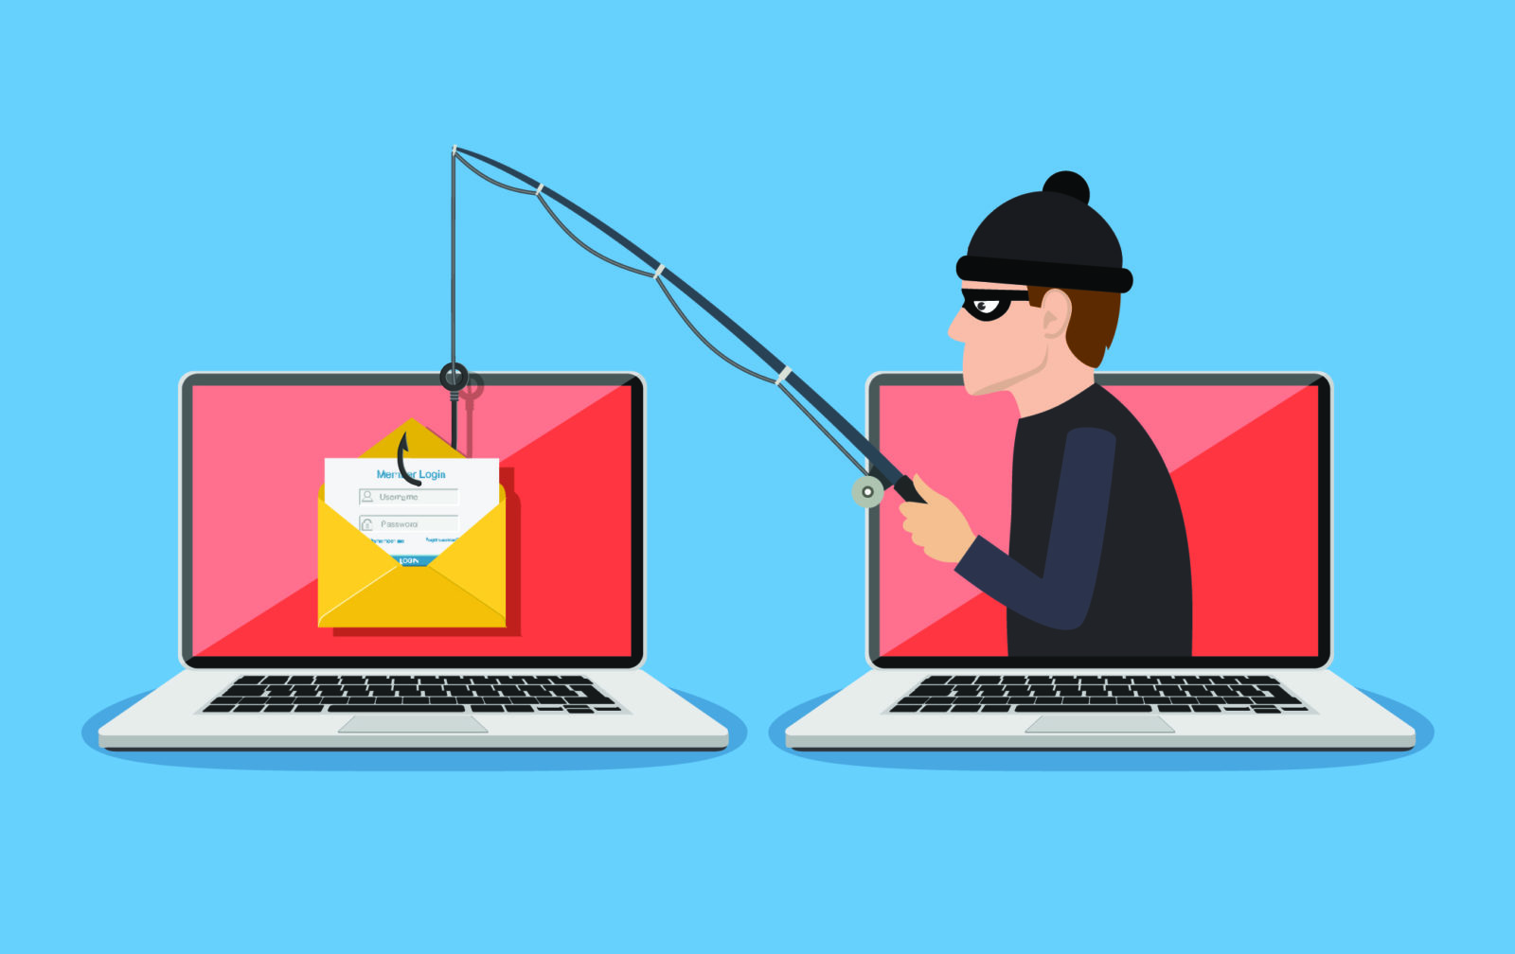

Introduction
Phishing is a type of cyber attack that uses deceptive messages to trick victims into revealing sensitive data such as login credentials, banking information, or personal identity details. These attacks typically impersonate trusted sources via email, messaging apps, or cloned websites.

Slide 3
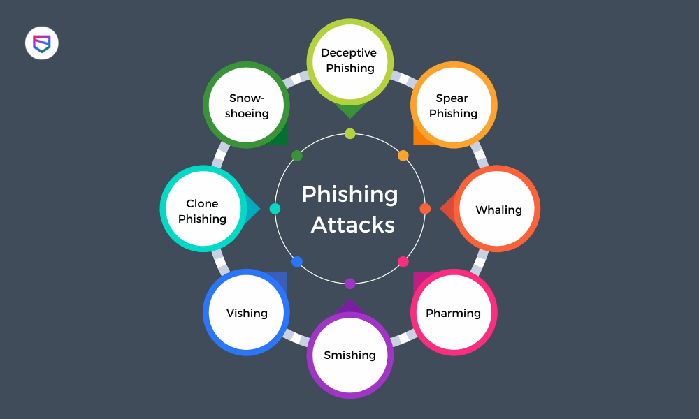
Types of Phishing Attacks
Email Phishing – Mass emails with fake links or attachments to steal credentials.
Spear Phishing – Personalized attacks targeting specific individuals using gathered information.
Whaling – High-profile attacks on executives or senior officials to steal sensitive data or authorize fraudulent transactions.

Slide 4
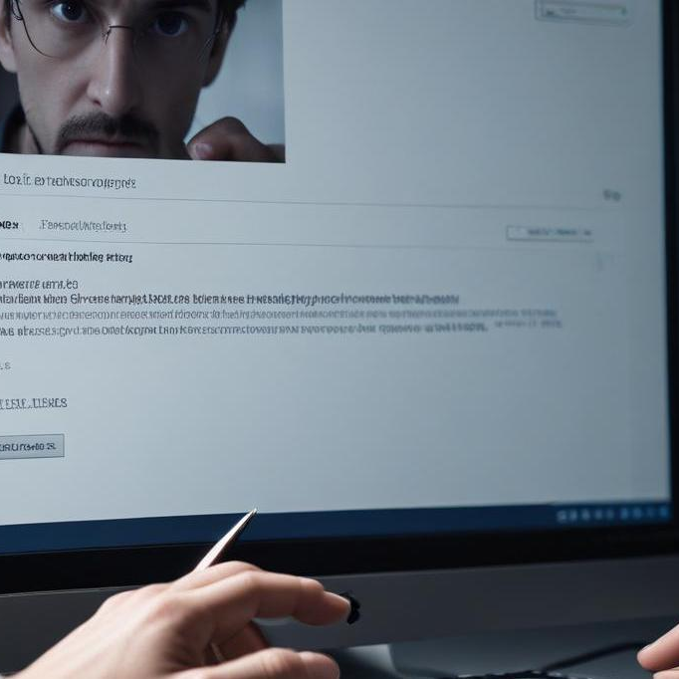
Smishing – Phishing via SMS, tricking users into clicking malicious links or sharing personal info.
Vishing – Voice-based phishing where attackers impersonate officials to extract sensitive data over calls.
Clone Phishing – Replicating legitimate emails with malicious links to deceive recipients.

Slide 5
Recognizing Phishing Emails
📧 Check Sender’s Email – Look for slight misspellings or unfamiliar domains.
🔍 Spot Errors – Poor grammar and spelling mistakes are red flags.
🔗 Hover Over Links – Verify URLs before clicking to avoid malicious sites.
⚠️ Beware of Urgency – Scammers create panic to trick you into acting fast.
📎 Fake Attachments – Unexpected files may contain malware—don’t open suspicious ones.

Slide 6
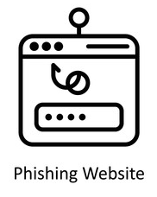
Phishing Websites & Red Flags
🔒 Check for HTTPS & Padlock – Secure sites use HTTPS, but not all HTTPS sites are safe.
🌐 Verify the Domain – Look for misspellings (e.g., g00gle.com vs. google.com).
⚠️ Beware of Pop-ups – Fake login prompts may steal your credentials.
📂 Avoid Unknown Downloads – Malicious files can install malware on your device.

Slide 7
Social Engineering Tactics
🎭 Pretexting – Attackers impersonate trusted figures (e.g., IT staff, banks) to manipulate victims into revealing confidential data. They often create believable scenarios to gain trust.
🎁 Baiting – Fraudsters lure victims with free offers, USB drives, or fake downloads that contain malware or steal credentials. Curiosity or greed often leads to compromise.
🔄 Quid Pro Quo – Scammers promise benefits like tech support or exclusive services in exchange for login details or access to systems, exploiting human nature to gain control.

Slide 8
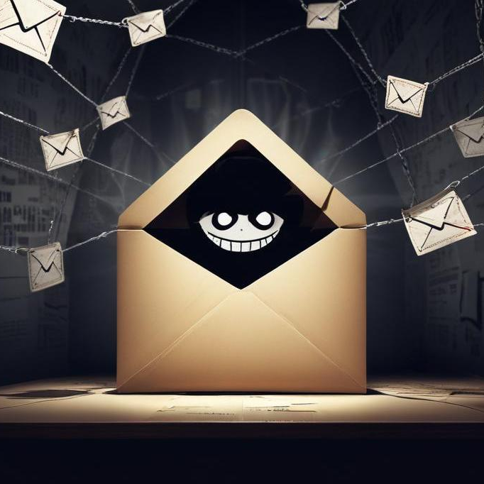
Best Practices to Stay Safe
MFA: Enable Multi-Factor Authentication for all accounts.
Updates: Regularly update software & security patches.
Passwords: Use a password manager & strong, unique passwords.
Reporting: Immediately report suspicious emails to IT/security.
Verify Links: Avoid clicking on unknown links; verify URLs.
Secure Networks: Use secure, private Wi-Fi; avoid public networks for sensitive tasks.
Data Backup: Regularly back up important data.

Slide 9
What to Do If You Get Phished
Phishing Response: Immediate Actions
Change Passwords: Secure all compromised accounts.
Report Incident: Notify IT/Security teams ASAP.
Monitor Accounts: Check for unauthorized activity.
Educate Others: Share your experience to prevent repetition.
Isolate Devices: Disconnect affected devices from the network.
Review Transactions: Check bank/credit card statements for fraud.
Document Everything: Keep records of the incident.
Consider Credit Freeze: If sensitive data was exposed.

Slide 10
Conclusions
In conclusion, an effective phishing awareness training program encompasses identifying various phishing types, such as email phishing, spear phishing, and whaling, alongside implementing robust prevention measures. By recognizing red flags, utilizing security tools, and promoting a proactive reporting culture, organizations can significantly reduce the risk of falling victim to phishing attacks and foster a secure operational environment.

